Slide 1
Technology Stocks' Performance on 18th April 2019
Source: Yahoo! Finance

Slide 2
Objective
Analyze the performance of the technology sector for the day including:
Overall gain/loss
Top gainers/losers
Any outliers
How was the gain/loss widespread related to factors like volatility and market capitalization

Slide 3
Webscraping
Tool Used : Scrapy
start_url : 'https://finance.yahoo.com/sector/ms_technology’
Day’s performance of 467 stocks scraped from 5 pages
name
price
change
perc_change
volume
volume_3_mth_avg
market_cap
pe_ratio
For each stock additional information picked-up from summary tab
beta_3y_mthly
one_yr_target_est

Slide 4
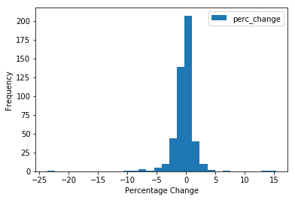
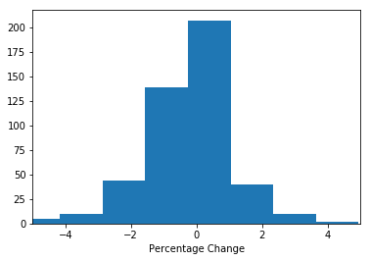
Not a Good Day for the Technology Stocks
242 stocks out of 467 had negative returns.
Mean percentage change over previous day was -0.24% (with a standard deviation of 2.17%)
There is a skew to left even after excluding outliers

Slide 5
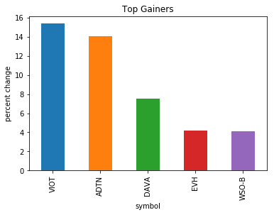
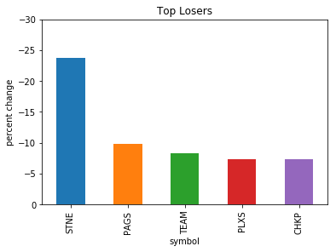
Winners and Losers

Slide 6
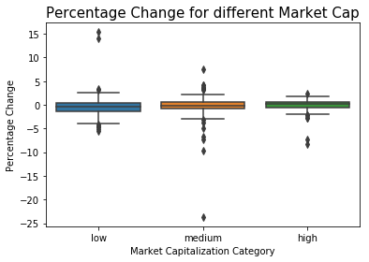
Market Capitalization didn’t Help
% loss was higher for some of the higher market capitalization stocks, as compared to low makt cap stocks, which is not a good sign

Slide 7
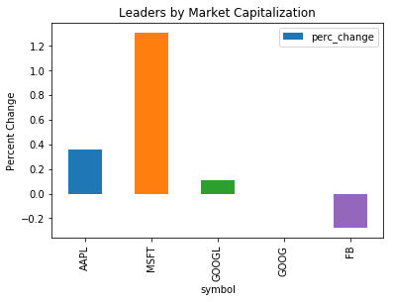
Big Names Survived

Slide 8
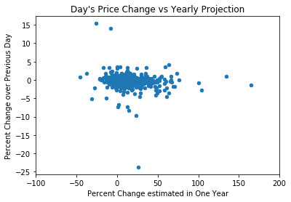
Day's Price Change was not highly linked to Estimated Price in One Year

Slide 9
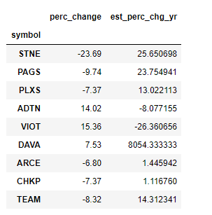
Outliers
Endava plc (DAVA) Analyst Opinion (4/22/2019) Source: https://postanalyst.com Endava plc is currently rated as outperform by 5 stock analysts, with the company still having around 2.87% shares outstanding that can be sold short legally. The value of their shares went up by 12.57% last month. Over the course of a year, the stock has grown by 24.22%. Financial analysts are becoming more bullish than ever, with the 2 analysts who cover the activities of DAVA advising investors to buy. Experts on Wall Street have set a price target of $2426.27 for the stock. The decision was arrived after looking at their 7987.57% gain from current levels.

Slide 10
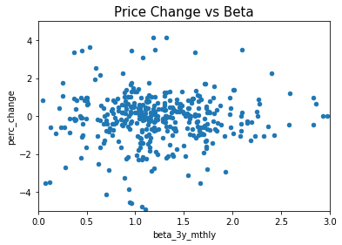
Price Change not due to Volatility
The day's price change was not related to systematic risk (beta).
This shows that the loss might be more sustained.

Slide 11
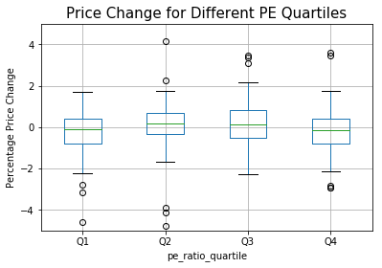
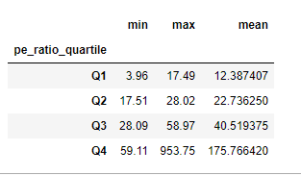
Percentage price change was not linked to the PE ratio

Slide 12
Future Work
The data-set analyzed is too small to arrive at any conclusions. Some more aspects that could have been covered are:
Exploration over a longer period
Comparison to other sectors
Comparison to macroeconomic factors

